Slide 1
Event driven machine learning
Natan Mish
Machine Learning Engineer
PyData London June 2023

Slide 2
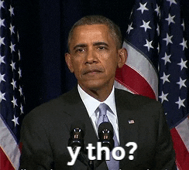
Why you should be interested
Paradigm shift in the software development discipline in recent years
Your machine learning model is in production (or on its way there)
You need your system to be responsive, relevant, resilient, maintainable and elastic

Slide 3

Natan Mish
Machine Learning Engineer at Zimmer Biomet
Scoping committee at DataKind UK
MSc in Social Data Science at the London School of Economics and Political Science
Previous experience in the transportation, fintech and finance industries
And…
Up until a few months ago I didn’t know much about event driven systems

Slide 4
Agenda
Introduction – what is Event Driven Architecture anyway?
Message driven
EDA Machine Learning use cases
Scalability/Elasticity
Serverless
Common pitfalls
Mini demo

Slide 5
DISCLAIMER
I have never built a fully event driven system myself
As every other framework in the industry, it is dynamic and constantly evolving
Event driven products will look different across different systems and different limitations
Definitely not suitable for every type of problem
This talk’s goal is an introduction to the framework and invitation to think how can the event driven architecture help you in your next Machine Learning project

Slide 6

Not sure about the cookies, but I promise the memes will get better…

Slide 7
What is Event Driven Architecture?
EDA for short. Not to be confused with that other EDA (Exploratory Data Analysis)
Accurately described in the Reactive Manifesto:
”…application requirements have changed dramatically in recent years. Only a few years ago a large application had tens of servers, seconds of response time, hours of offline maintenance and gigabytes of data…Nowadays users expect millisecond response times and 100% uptime. Data is measured in Petabytes. Today's demands are simply not met by yesterday’s software architectures…we want systems that are Responsive, Resilient, Elastic and Message Driven. We call these Reactive Systems.”
The Reactive Manifesto (Published on September 16 2014)

Slide 8
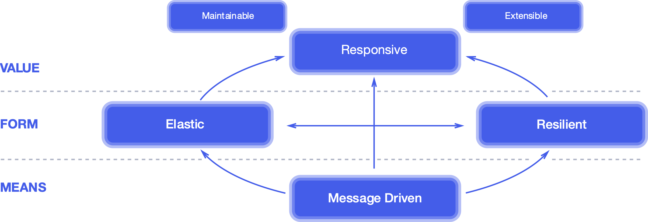
Reactive traits
Relevant

Slide 9
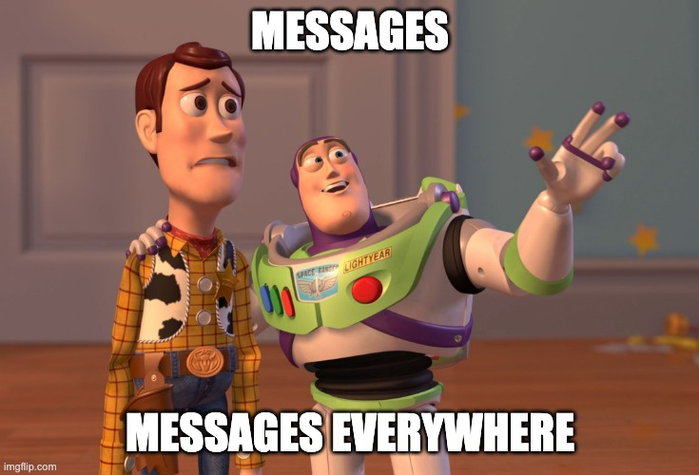
Reactive Principles and Patterns
Reactive Principles
Stay Responsive
Accept Uncertainty
Reactive Patterns
Partition State
Communicate Facts
Embrace Failure
Assert Autonomy
Tailor Consistency
Decouple Time
Decouple Space
Handle Dynamics
Isolate Mutations
Coordinate Dataflow
Localize State
Observe Communications

Slide 10

Events ⬄ Messages
EDA is mostly centered around the message queuing system
A message queue is a form of asynchronous service-to-service communication
Two of the most popular open source frameworks are Apache Kafka and RabbitMQ
For a deeper dive I recommend Francesco Tisiot’s tutorial →
https://youtu.be/LX7po4xYGYI

Slide 11
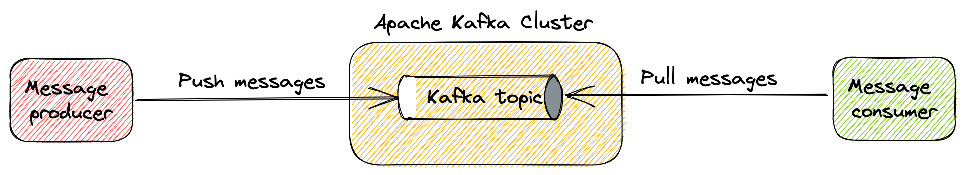
How does Kafka work?

Slide 12
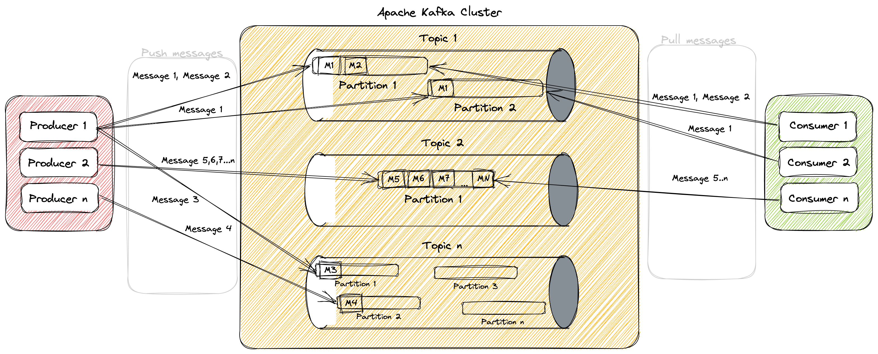
Multi topic distributed cluster

Slide 13

Basically this…

Slide 14







Function as a Service
Cloud resource that enables developing, running and managing application functionalities without the complexity of building and maintaining the infrastructure typically associated with developing and launching an application
As a serverless framework, it achieves the responsiveness and elasticity requirements
There are commercial and open source solutions

Slide 15
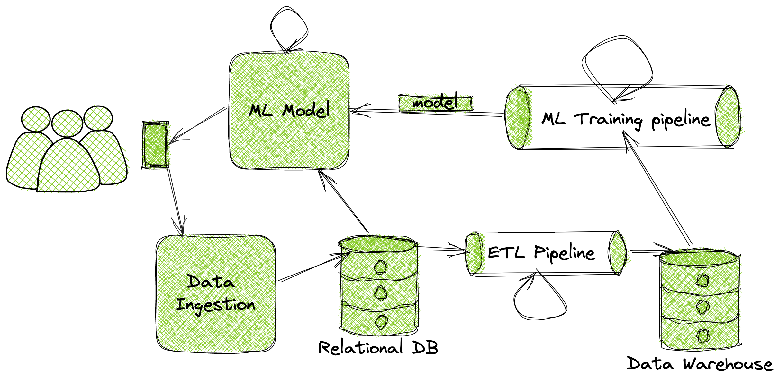
Standard Machine Learning System

Slide 16
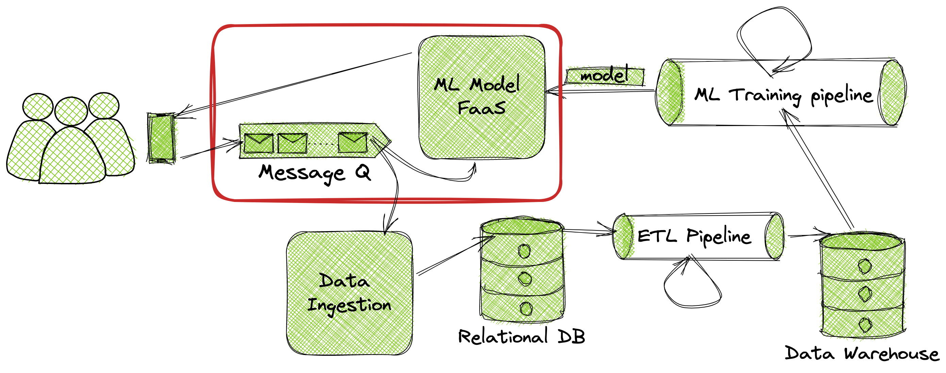
Use Case I: Online Inference using FaaS

Slide 17
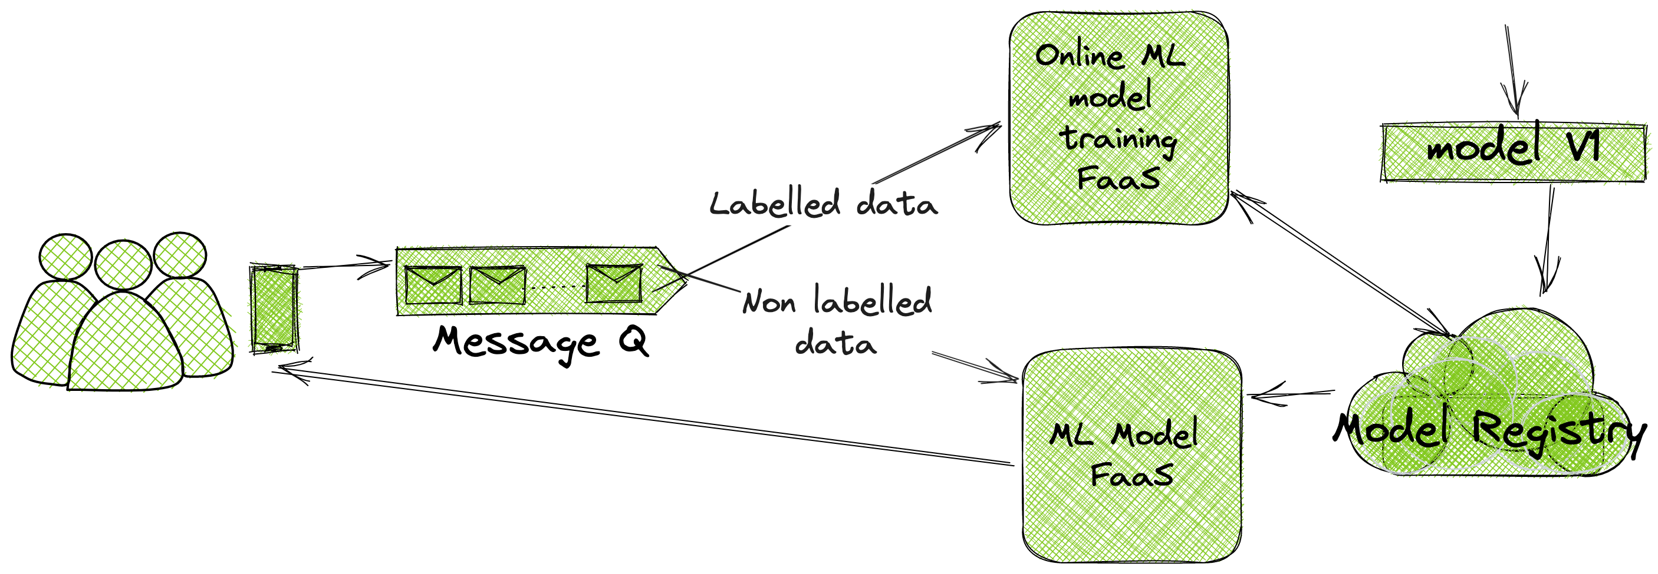
Use Case II: Online/Continual/Incremental Learning

Slide 18
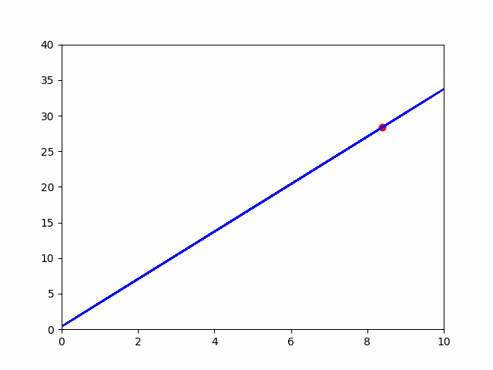
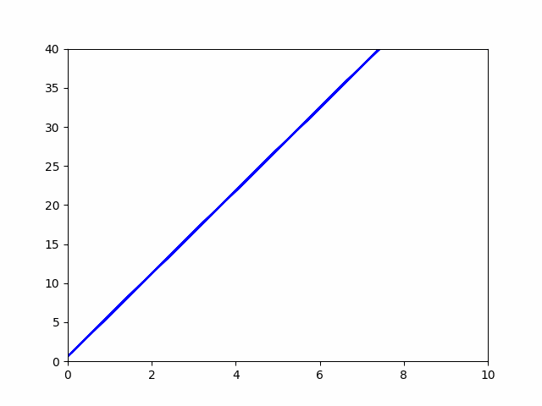

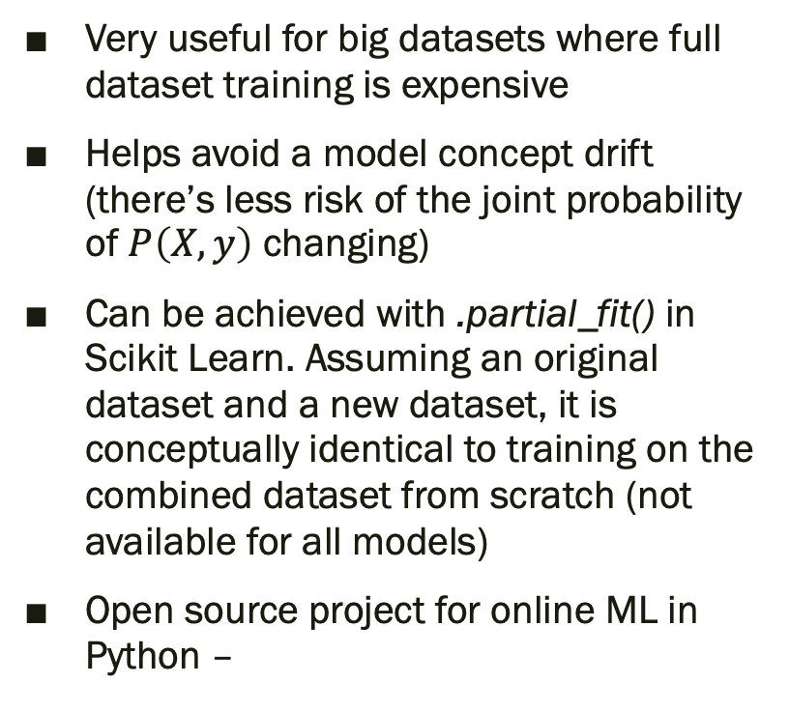
Online/Continual/Incremental Learning
Very useful for big datasets where full dataset training is expensive
Helps avoid a model concept drift (there’s less risk of the joint probability of $P\left(X, y\right)$ changing)
Can be achieved with .partial_fit() in Scikit Learn. Assuming an original dataset and a new dataset, it is conceptually identical to training on the combined dataset from scratch (not available for all models)
Open source project for online ML in Python –
Concept Drift

Slide 19
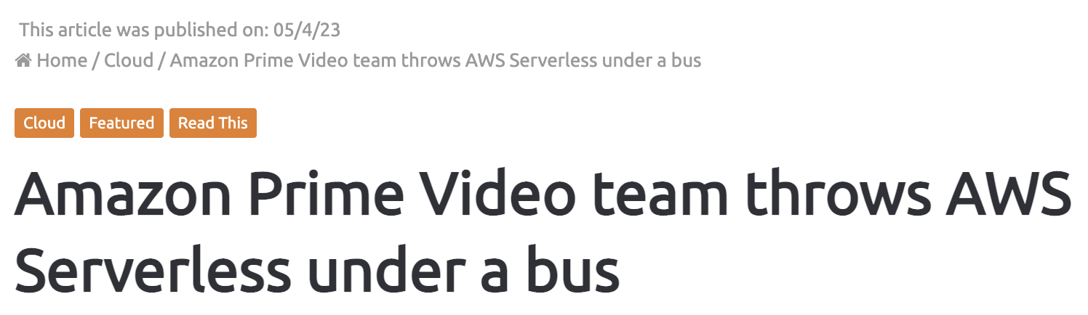
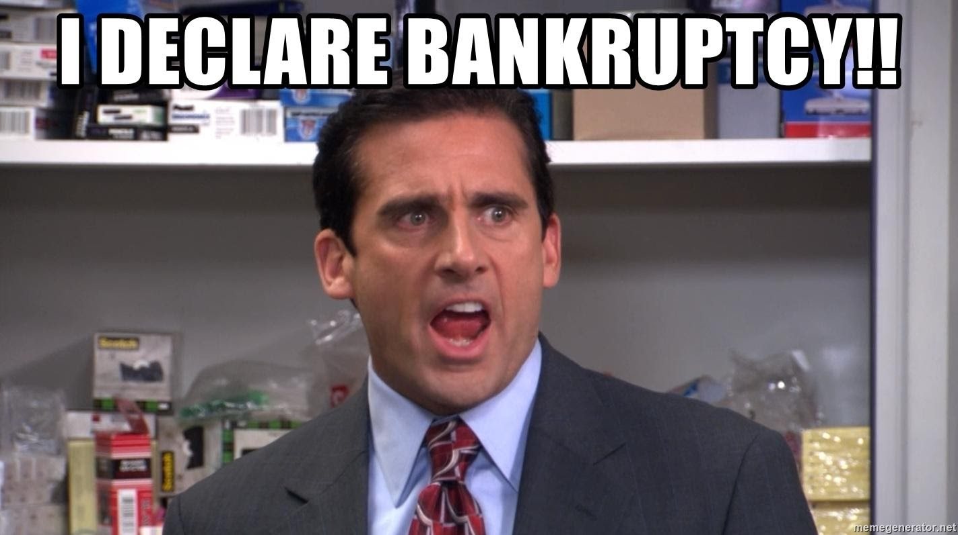
Serverless
There is actually a server under the hood
https://thestack.technology/amazon-prime-video-microservices-monolith/
Saves time and effort
Probably does not save $$$

Slide 20

Common pitfalls and how to avoid them

Slide 21
Common pitfalls and how to avoid them
Data loss
Backup idle data
Simulate services breaking (chaos monkey)
Versions
Schema, models, components, tools, systems
Congestion
Write representative stress tests
Identify slow processes
Allow long retention periods on message queues
Isolate bad data
Ideally align versions across your system
Should be covered by tests
Break down to micro services
Prefer async vs. sync

Slide 22
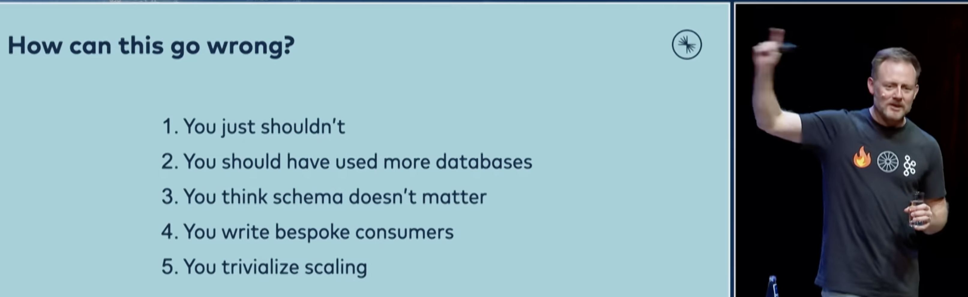
Common pitfalls and how to avoid them
Tim Berglund, Event-Driven Architectures Done Right,
https://youtu.be/A_mstzRGfIE

Slide 23
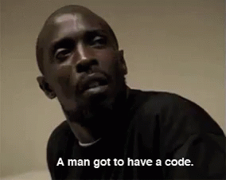
Mini Demo

